Slide 1
Embrace the Suck
Tobi’s Down and Dirty Guide
How to write 50K words during NaNoWriMo
This presentation can be found at tobidoyle.com

Slide 2
Tobi’s Rules
Suggestions are meant to be helpful, take what works, ignore what doesn’t, and your mileage may vary.
Suggestions work for any genre/style of writing, I promise.
Following my suggestions will not make you a NYT Best Seller. You need a great story with amazing characters and fabulous editors to help you.
My advice is for people who want to have others read their work.
Every story has a beginning, a middle, and an end.

Slide 3
Embrace the Suck
Pull at, extract, dissolve, absorb
And you DO want to write an absorbing story that readers can’t put down and maybe even extract a feeling or lesson from.
Slang – when your efforts do not achieve the intended goal
Sucking leaves a void, or a vacuum.

Slide 4
Embrace the Suck
NaNoWriMo = 1700 words a day for thirty days.
Give yourself permission to suck.
I give you permission to suck.
It doesn’t have to be good, it just has to be words.

Slide 5
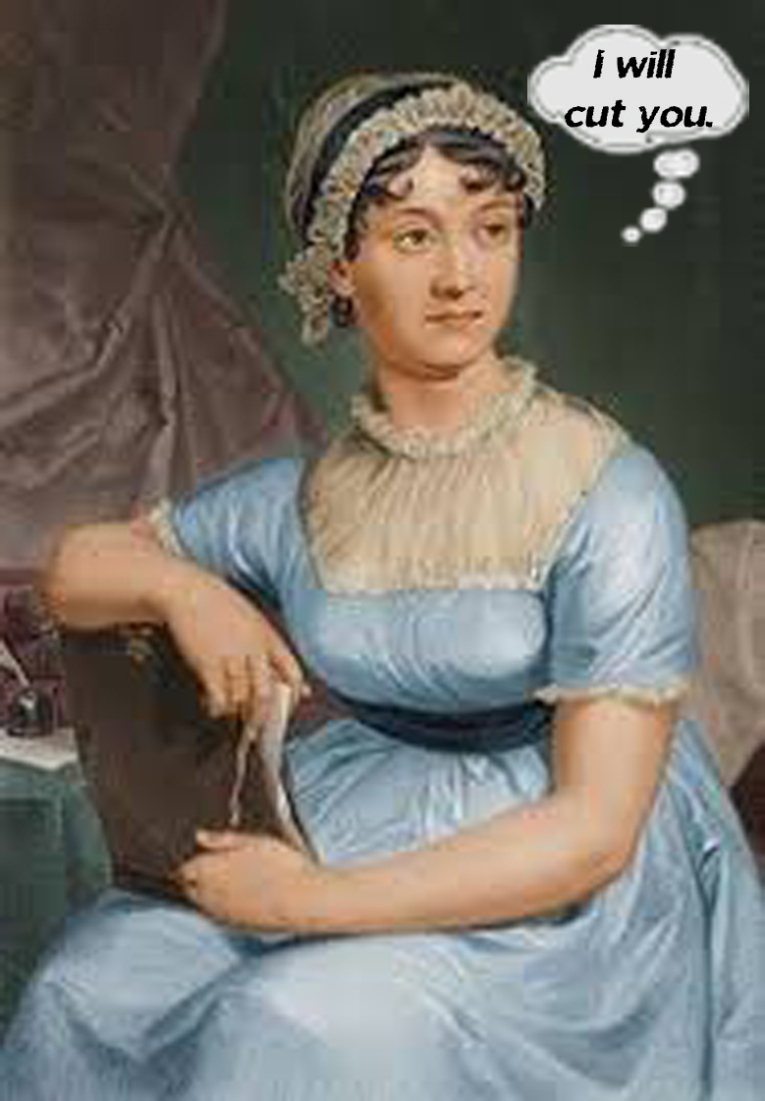
But… How do you suck with style?
What’s your story idea?
Are you writing a mystery, romance, suspense, spy novel, thriller, non-fiction, coming-of-age, women’s, speculative fiction, memoir, humor, literary, essays, poetry?
Do you read the genre you write?
If the answer is no…
Where does your story idea fit in a library?
Is your book genre not listed above? That doesn’t make it literary fiction. Have you created a story that has never before been published. Chances are there’s a reason for that. Remember rule 4…

Slide 6
What’s literary fiction?
The accepted definition of literary fiction is that it has literary merit.
What is literary merit and who decides?
Subjective because it judges art, and that is personal
LitFic endures the test of time, realistic characters, emotional complexity, concerned with the truth
Literary fiction is character driven and usually slower paced.
There must be character growth or showing that the inability of the character to change ends in tragedy. Example: Khaled Hosseini A Thousand Splendid Suns
In truth, ALL books should be about character growth. Even the reader grows with non-fiction books.

Slide 7
What’s speculative fiction?
The setting is other than the real world, involving supernatural, futuristic, or other imagined elements.
Examples:
Sci/fi
Paranormal – werewolves, vampires, fairies and more
Time travel
Steampunk
Dystopian/utopian
And many more

Slide 8
Sucking with Style: Know your Genre Promise
Non-fiction = information is presented in an engaging manner.
Mystery = mystery solved.
Horror = evil thwarted.
Romance = happily ever after.
Suspense/Spy/Thriller = crises averted
Speculative fiction usually have a subgenre, like SciFi Horror or Paranormal Romance where the world building is integral to the story, and you can’t break your own rules.

Slide 9
Sucking with Style: Character’s suck leaves a void
Character growth is paramount to an enjoyable read.
Think Scrooge, or Harry Potter, or Odysseus
How will your character grow throughout your book?
What was Scrooge’s suck, his void?
He wanted gold to prove he was valuable.

Slide 10
Character’s Suck Exercise
Your character wants something at the beginning of the book. Maybe more than one thing. What is it?
Why does your character want it? What’s his motivation?
What is he willing to sacrifice to obtain it?
Will your character get this thing or will they change their mind?
Example: Scrooge no longer cares about getting ALL the money, now he wants familial love.

Slide 11
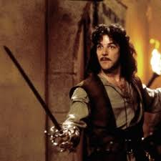
Can you up the suck?
Examples of weak suck…
Wants to have sex.
Wants money.
Wants revenge because character stole his lunch out of the fridge.
Up the suck.
Want to have a baby to harvest stem cells and save child.
Needs money or he’ll lose his business and put hundreds out of work and ruin the town’s economy.
Wants revenge because villain killed his father, and then his mother had to work as a prostitute and was murdered forcing him and his sister into foster care where she was abused and eventually committed suicide.
Tobi’s Tip: You might not have this down yet. Sometimes you up the suck on revision, but maybe think about it now and jot down some notes.

Slide 12
Exercise: MadLibs for your story Stolen from Damon Suede’s RWA18 “Happier Endings” Workshop
To deal with (suck), (character) needs to (action) (objective).
To deal with terrorists dirty bomb threat, Jack Ryan needs to find and kill bad guys before dirty bomb explodes. (Thriller)
To deal with Voldemort, Harry Potter needs to sacrifice himself. (Speculative/Coming of Age)
To deal with justice, Hercule Poirot must solve the murder mystery before the train reaches the station. (Mystery)
To find love, Darcy must overcome his belief that he must behave in a certain manner in order to honor his parents and their legacy and show Lizzie Bennett that he is worthy of her love. (Romance)

Slide 13
Note the objective fulfills the genre promise
To deal with (suck), (character) needs to (action) (objective).
Kill bad guys before dirty bomb explodes = Thriller/Spy
Destroy Voldemort, Sacrifice self = Speculative Fiction/Coming of Age
Solve who-done-it before train arrives at station = Mystery
Prove worthy of love = Romance
THIS MEANS YOU KNOW THE END POINT OF YOUR STORY!

Slide 14
You’ve got characters, you’ve got an ending
It’s like you’re 2/3rds done with NaNo already and it hasn’t even started yet!
Your book has practically written itself.

Slide 15
Tips to suck readers into the middle bit.
The equation – To deal with (suck), (character) needs to (action) (objective) works for EVERY scene.
Example – Harry Potter – seven books to get to the ultimate ending, each scene building toward Harry believably motivated to willingly sacrifice himself for his friends and family.
11 year old Harry wouldn’t have been capable of that without his coming of age journey.
Also – it’s pretty awesome that he sacrifices himself like his mother did for him.

Slide 16
Suck energy from your characters to write
Every day ask yourself – what does my character need to do to achieve his goal.
AND WRITE THAT SCENE – IT’S OKAY IF IT ISN’T PERFECT
Don’t let them have their goal without a fight.
Every scene – except for the final scene – should end with
Yes, he achieved the goal BUT…
Or No, he didn’t achieve his goal AND…
The BUT and AND are you adding obstacles, conflicts, that are believable.

Slide 17
Psychology of Fiction Stolen from Jennifer Lynn Barnes, PhD
Human animals enjoy fiction for a few reasons…
Social practice and social simulation – we watch how characters interact and how they feel about it
Social surrogacy – we need to belong to a group
We enjoy gossip
We like to see morality played out – good triumphs over evil
Prop for our own make-believe – day dreaming about characters
For pleasure: Our id enjoys beauty, power & status, wealth, competition, touch, and vicarious danger.

Slide 18
Use psychology to strengthen your story
Remember your character’s goals, motivations, and conflicts– or objectives, needs, and sucks as we’ve been calling them?
Use cognitive science and psychology to make them believable (Remember Rule 4)
Tobi’s Favorite Resource
Angela Ackerman and Becca Puglisi – The Wound Thesaurus
But I also love their Emotion Thesaurus when developmentally editing
And their Positive and Negative Trait thesauruses and darn good, too.

Slide 19
By November 10th the suck may be strong
Write in chunks. 20 minutes at a time.
Write the scene. Character wants THIS and DOES THIS but then THIS HAPPENS…
Give yourself permission to suck, just put the words down.
This is a first draft, a rough draft, don’t worry about editing.

Slide 20
Tobi’s Tricks
Timed sprints allow you to write with no editing allowed.
If you can’t think of a name or word, use caps and come back and fix it later.
SG Redling uses the word PUMPKIN to make it easier to search.
I use all caps, example
He pushed the button and the lights of a NEED NAME OF AN IMPORT SEDAN WITH TRUNK SPACE BIG ENOUGH FOR 300lb MAN blinked twice, casting an orange glow across the glossy cement.
I prefer to write in the morning, edit in the afternoon, meaning I do go back and fix the caps and egregious grammar later that day.
Jodi Picoult writes the scene, then the next day she edits the scene and writes the next one.

Slide 21
Join other writers and commiserate
Cabell County Library has write-ins
Panera at the mall – 10am-12 on Wednesday write in
Facebook group - Huntington WV NaNoWriMo

Slide 22
Check list for NaNo
Characters
What do they want?
Why do they want it?
Genre promise
How will they get what they want, one scene at a time.
Write sucky words
Plan to fix the sucky words in January. (Jan. 14th – Cabell Library 5:30-8)

Slide 23
What to do when your done with your 50K
Celebrate with us
Take a break from your story (time away gives you perspective) and this is a great time to read books in your genre.
Distance helps your ego deal with critique. (Remember Rule 4)
Editing… Start with the big picture and then work your way to the grammar.

Slide 24
Editing–A very painful but necessary time suck
Developmental editing – plot and structure only (online class at margielawson.com)
talk your plot out with others
Join us Jan 14th – 5:30-8 at Cabell County Library – bring your WIP
Line editing – addresses the creative content, writing style, and language use at the sentence and paragraph level. It focuses on the way you use language to communicate your story to the reader.
Copy editing – grammar, spelling, etc.
Proof reading – more than one set of eyes help.
Beta readers are great for this, and hopefully they’ll tell you if your characters are consistent or you have plot holes.

Slide 25
Resources
Nanowrimo.org
NaNoPlanO Weds Oct. 24th at Cabell County Main Library 6-8
Facebook Groups for local authors:
Huntington WV NaNoWriMo
Wicked Wordsmiths of the West
West Virginia Writers
Patchwork Writers
tobidoyle.com
Outline Your Novel in Thirty Minutes by Alicia Rasley: http://www.aliciarasley.com/artout.htm

Slide 26
Shameless Plug
November 2-3rd Rebels and Readers at Pullman Plaza Hotel
Tickets available through eventbrite.com
80s cocktail party Friday night, signing Sat
More than 80 romance authors signing books – and models
Books Available for Sale through Amazon and other retailers
Write a review for the last book you read on Goodreads and/or Amazon.

